Slide 1
Ohio AgrAbility Design Solutions Developed in a First-Year
Engineering Innovation Course
2014 AgrAbility National Training Workshop
April 1, 2014
Lexington, KY
 Kenya M. Crosson, Ph.D., § Dee Jepsen, Ph.D.,
§ Kent McGuire, *John Zeller
 University of Dayton, §The Ohio State University, *Easter Seals Tristate

Slide 2
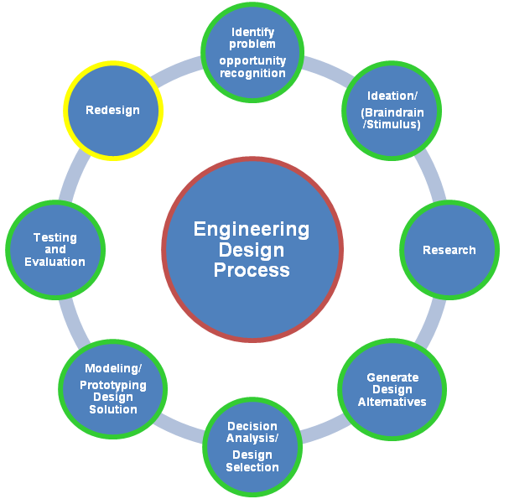





EGR 103 Engineering Innovation Course
  Engineering design course
  University of Dayton (UD)
  first –year engineering students
  Project-based learning
  Service-learning
  Client- student interaction
Innovation
Project Management
Teambuilding
Technical Communication

Slide 3

Ohio AgrAbility-UD EGR 103 Partnership
4-year partnership that began in 2010
Ohio AgrAbility served as project client for one section of the EGR 103 course since the Spring 2010 semester (9 semesters)
  Student interaction
  Project introduction
  Scheduling and organizing site visits
  Connecting with resources and AgrAbility clients
  Attending presentations and providing feedback
UD faculty member, teaching assistant and students
  Promote and advance AgrAbility’s mission
  Course management (faculty)
  Project guidance (faculty and TA)
  Design solutions and prototypes
  Mentoring (faculty and TA)
Ongoing
Adaptive
Collaborative
Notes:
3

Slide 4


Snapshot of UD First-year
Engineering Students in EGR 103
Extensive science and math experiences
Varied engineering experiences
Limited to no agriculture experience
High achievers
Value sustainability and servant leaders
Proficient oral speakers
DISC personality style
  Dominant
  Influencing
  Steady
  Cautious
Diverse- international, female students
Notes:
4

Slide 5
Design Project Problem Statements-
Evolution & Components
General Composition and Themes
  National AgrAbility and Ohio AgrAbility background
  “Design a cost-effective, innovative technology for the Ohio AgrAbility Project and its clients” and $50 project budget per team
  “Universal design of software, processes, devices for prevention or support services”
  Deliverables
  Design activities and timeline
  Information resources
Spring 2010
Fall 2010
Spring 2011
Notes:
5

Slide 6
Design Project Problem Statements-
Evolution & Components
Fall 2012 Updates/Additions
  “Universal design of software, processes, devices for injury/fatality prevention, support services, farm management/activities, sustainable farming, rehabilitation, or training”
  Inclusion of cognitive disabilities (e.g. autism)
  Added Design Requirements section- “$50 project budget, incorporate universal design, sustainability, constructed with handheld power tools, no craft materials, testable model/prototype, small size”
Spring 2013 Updates/Additions
  Inclusion of greenhouses/nurseries
Fall 2012
Spring 2013
Notes:
6

Slide 7
Design Project Problem Statements-
Evolution & Components
Fall 2013 Updates/Additions
  Innovative Design for Agriculture
  Highlight importance of agriculture in society
  “Design, construct, and test a cost-effective, innovative design for the agriculture industry that improves safety, sustainability, technology, or education for the Ohio AgrAbility Project and its clients”
Spring 2014- No Updates/Additions
Fall 2013
Spring 2014
Notes:
7

Slide 8
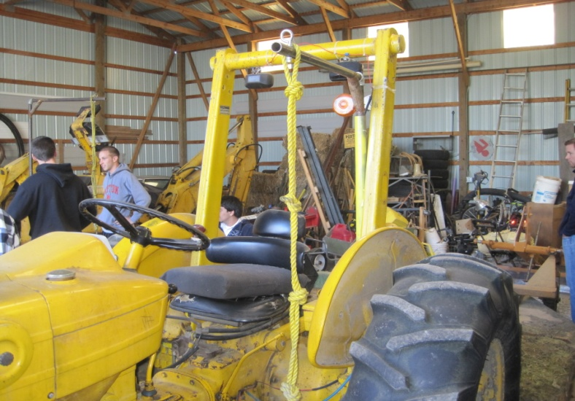
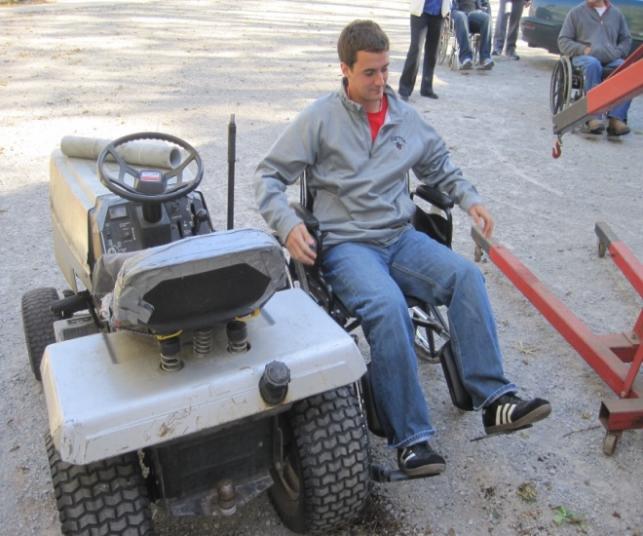
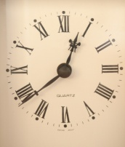
Site Visits/Stimulus
Timeline
Fall 2013 and Spring 2014:
Spring 2013:
Spring 2011 and Fall 2012:
Fall 2010: (poorly timed)
Spring 2010:
No site visits
Farm visit (Bill Wilkins)
Well-timed, farm visit (Bill Wilkins) and organic dairy farm
Well-timed, local greenhouse/nursery
Notes:
8

Slide 9
Client-Student Communication/Collaboration
Initially, used chat feature on course website (Spring 2010, Fall 2010)
Subsequent semesters, the interaction was facilitated by direct email contact, site visits, class presentations
Design Review presentation and Final Presentation- feedback from client
Professor plays a pivotal role in facilitating communication between both entities
Direct mentoring and guidance from professor and undergraduate teaching assistant
Notes:
9

Slide 10
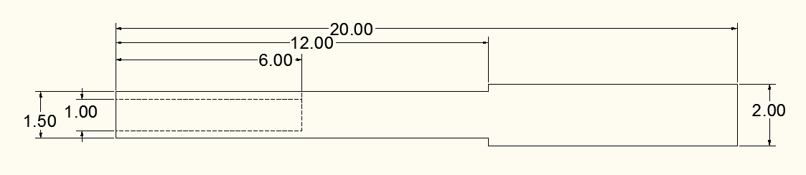
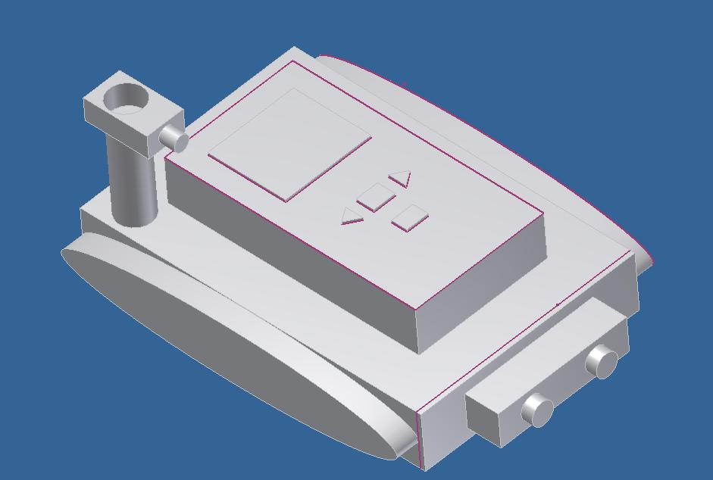
Spring 2010- Featured Design Solutions
Breaker Bar
6 total design solutions
Filter and fan for grain dust in silos
Safety harness for silo work
Compression glove for arthritis
Unmanned vehicle with camera
Notes:
10

Slide 11
Fall 2010- Featured Design Solutions
Key difference: site visit
7 total design solutions
Delta hook tractor hitch with camera (proof of concept)
Automatic fence (proof of concept)
Crane lift (proof of concept, small scale)
Notes:
11

Slide 12
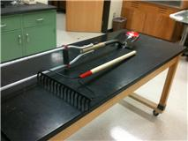
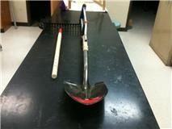
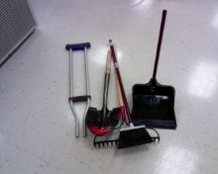
Fall 2010- Featured Design Solutions
Crutch Shovel with interchangeable tools
Notes:
12

Slide 13
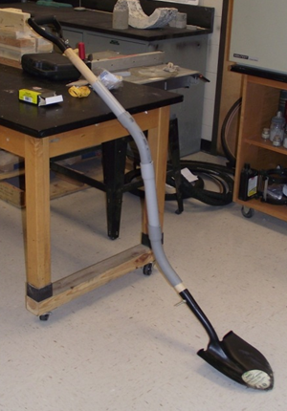
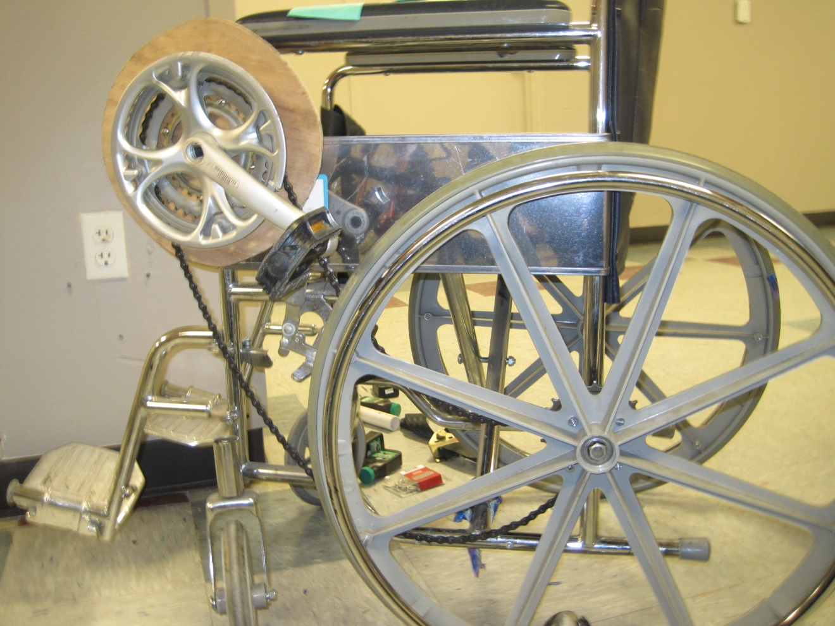
Fall 2010- Featured Design Solutions
Gear shifting wheelchair
Ergonomic Shovel
Notes:
13

Slide 14
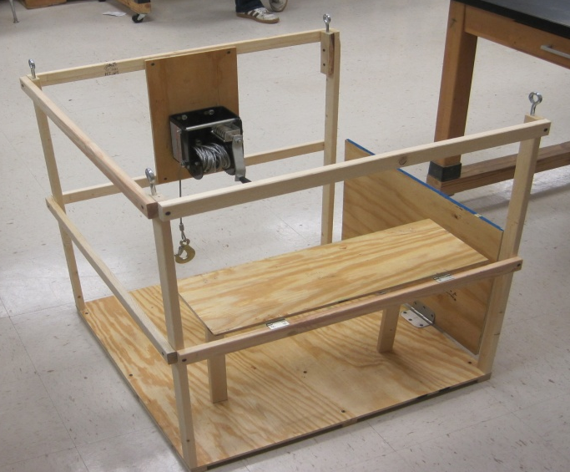
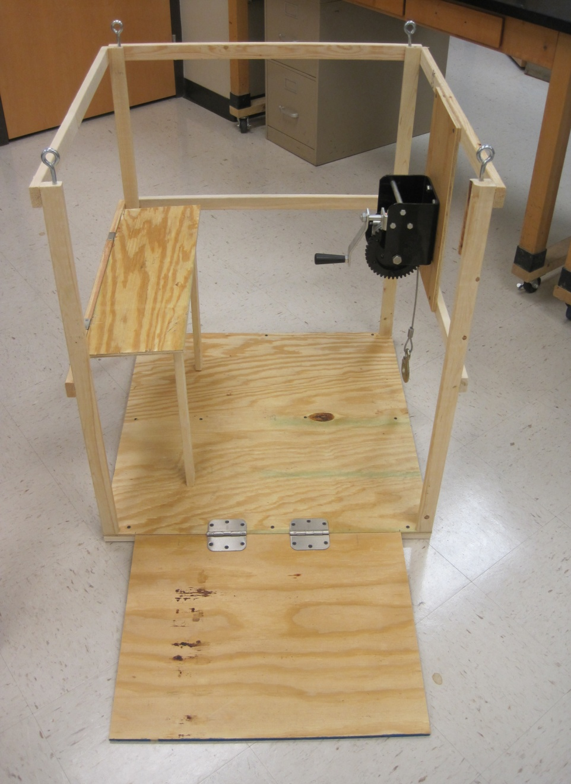
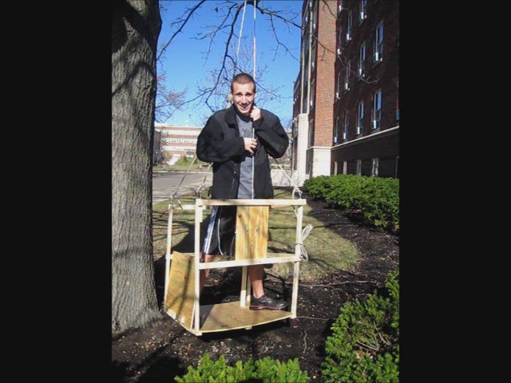
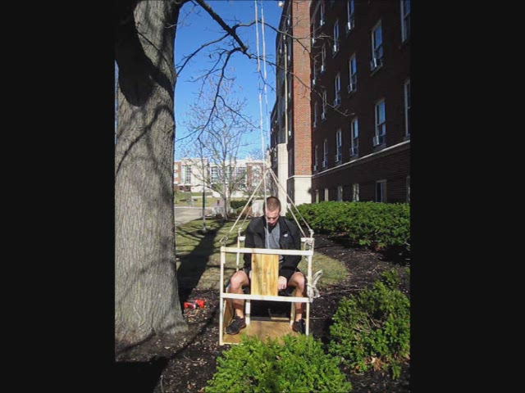
Fall 2010- Featured Design Solutions
Wheelchair lift
Notes:
14

Slide 15
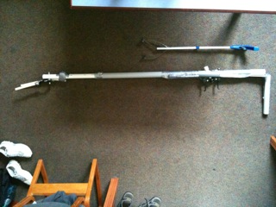
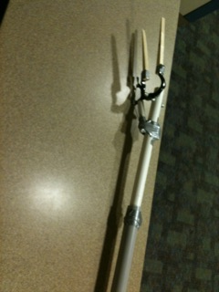
Spring 2011- Featured Design Solutions
Key difference: site visit to farm and organic dairy
5 total design solutions
Full body harness system for small farm equipment
Multi-use Bionic Arm Agricultural Tool
Notes:
15

Slide 16
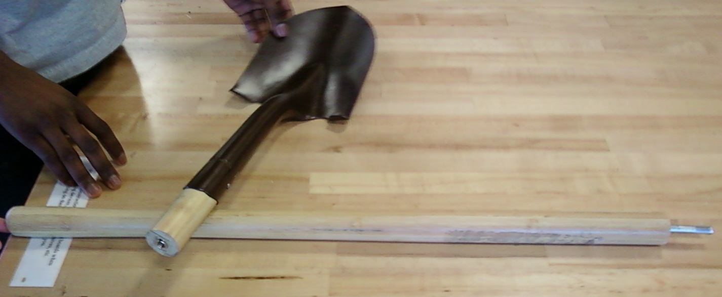
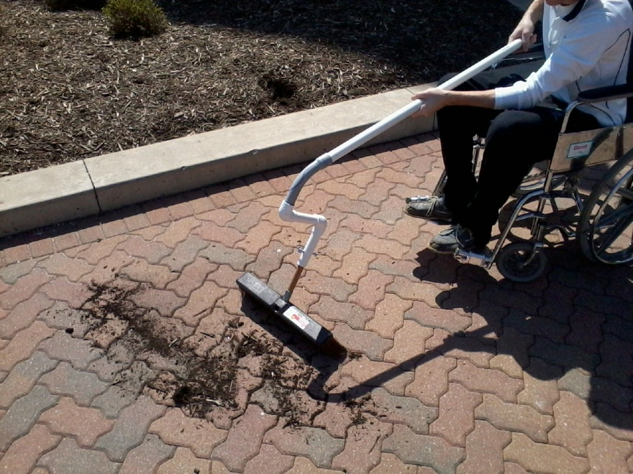
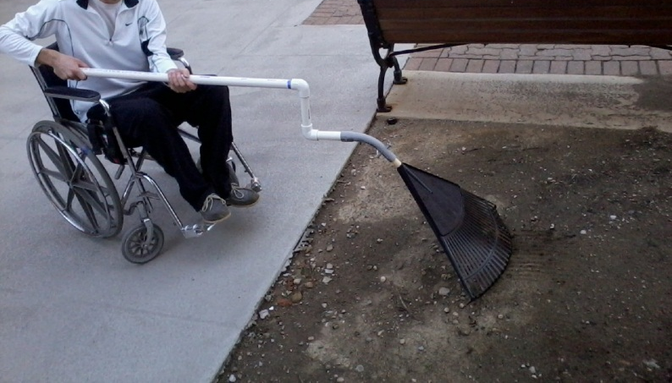
Spring 2011- Featured Design Solutions
Interchangeable shovel head with screw in handle
“Whippington”- articulating tool with interchangeable attachments
Notes:
16

Slide 17
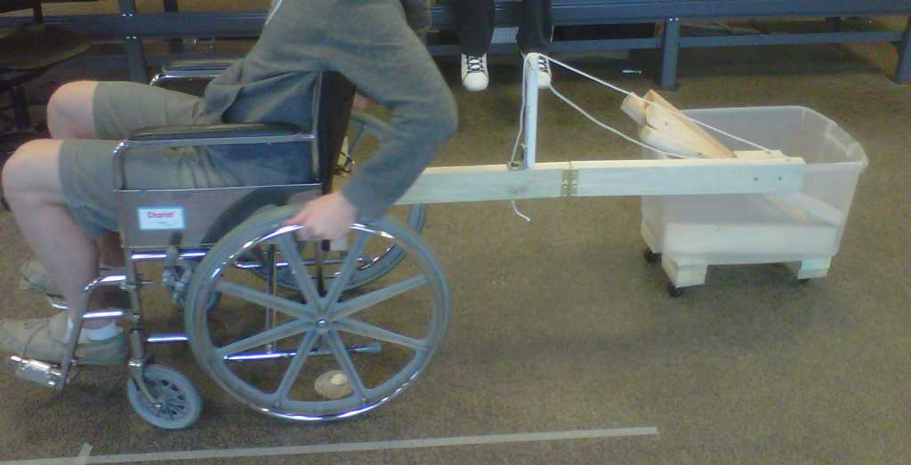
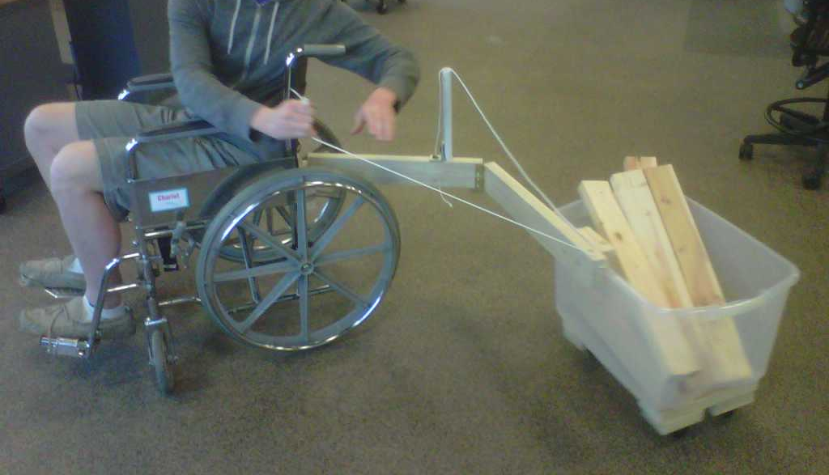
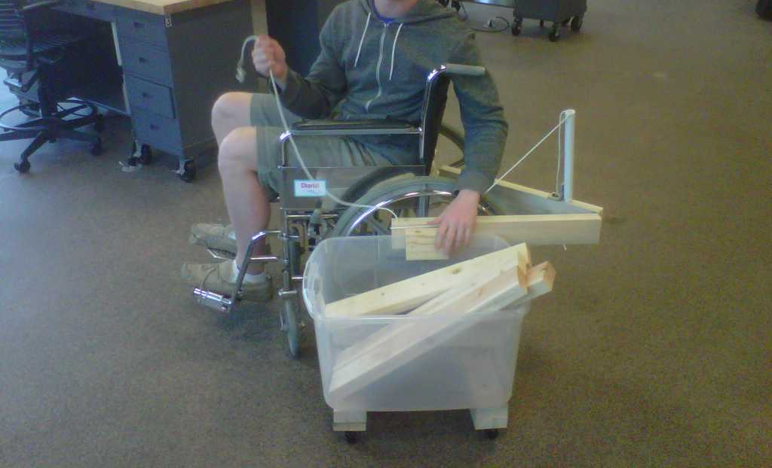
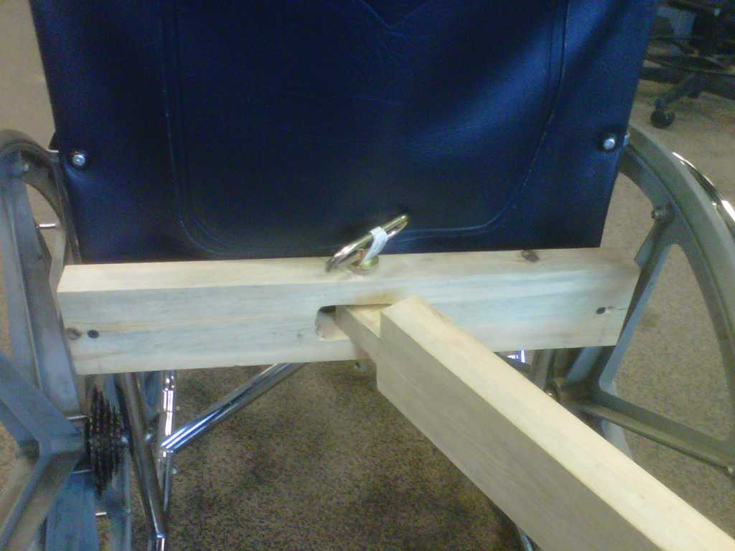
Spring 2011- Featured Design Solutions
Double-hinged Feed Cart
Notes:
17

Slide 18
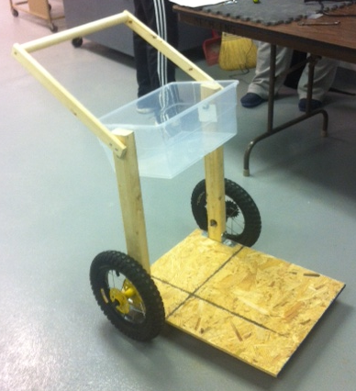
Fall 2012- Featured Design Solutions
Key difference: more limitations, sustainability, cognitive disabilities
7 total design solutions
Others:
  Small farm biodigester
  Wheelchair tool caddy
  Reusable, durable
wheelchair covers
Portable power for
Wheelchair
Barn rain collection system
Transport cart
(mobility limitations)
Notes:
18

Slide 19
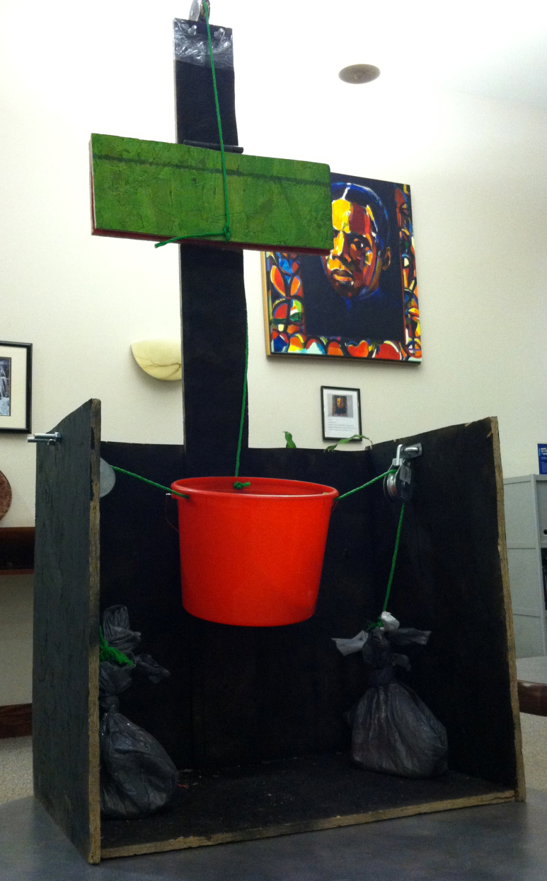

Fall 2012- Featured Design Solutions
Efficient Water Trough Device for Autistic Farmers
Notes:
19

Slide 20
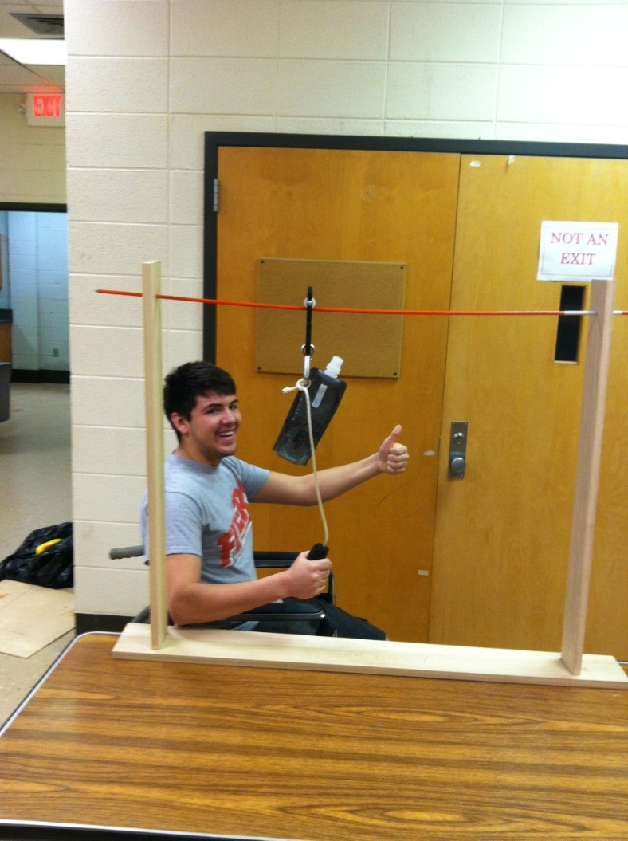
Spring 2013- Featured Design Solutions
Key difference: greenhouse/nursery site visit
8 total design solutions
Other designs:
  Compression shirt for
  Back support
  Tabletop slider to reach
  across greenhouse rows
Rail Hydration System
Notes:
20

Slide 21
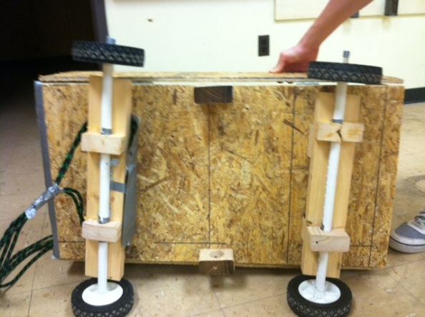
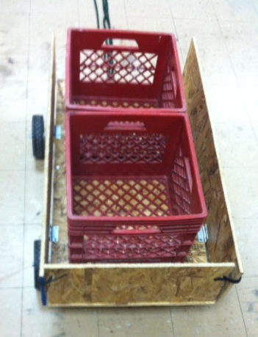
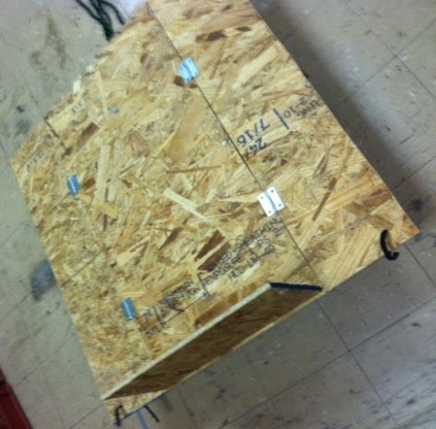
Spring 2013- Featured Design Solutions
Adaptable Crop Transport Cart
Notes:
21

Slide 22
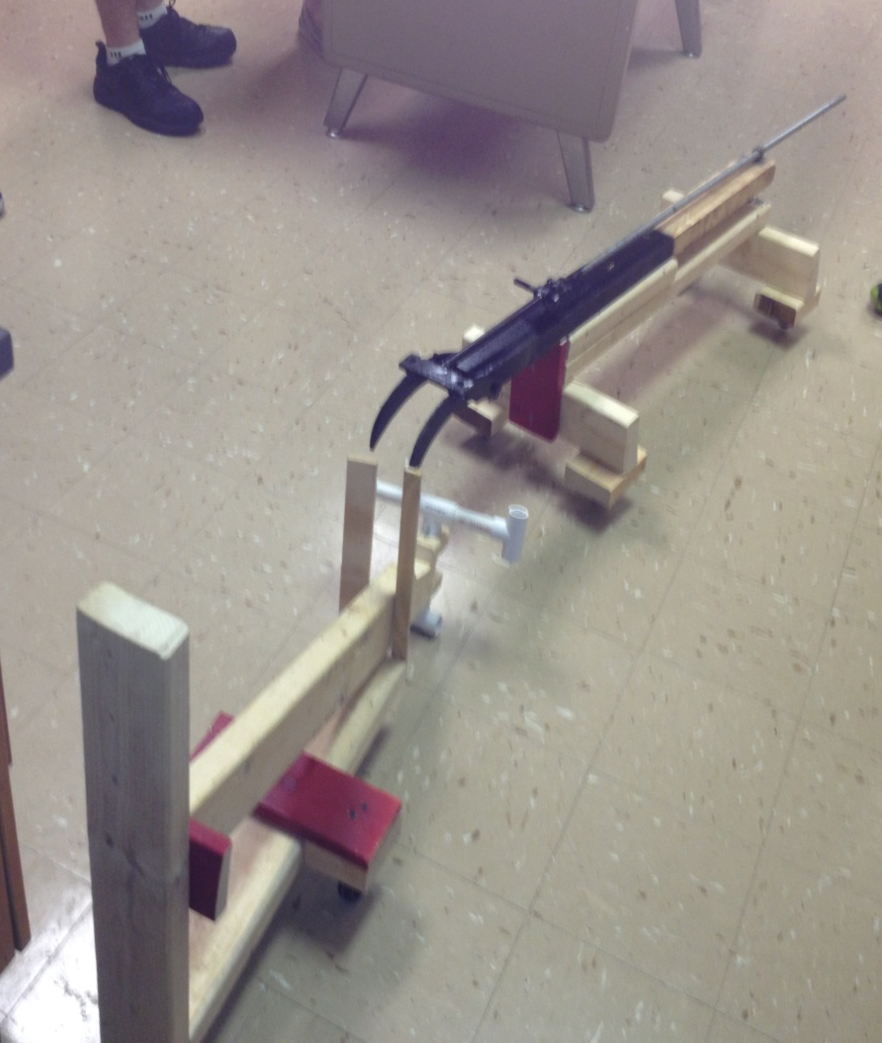
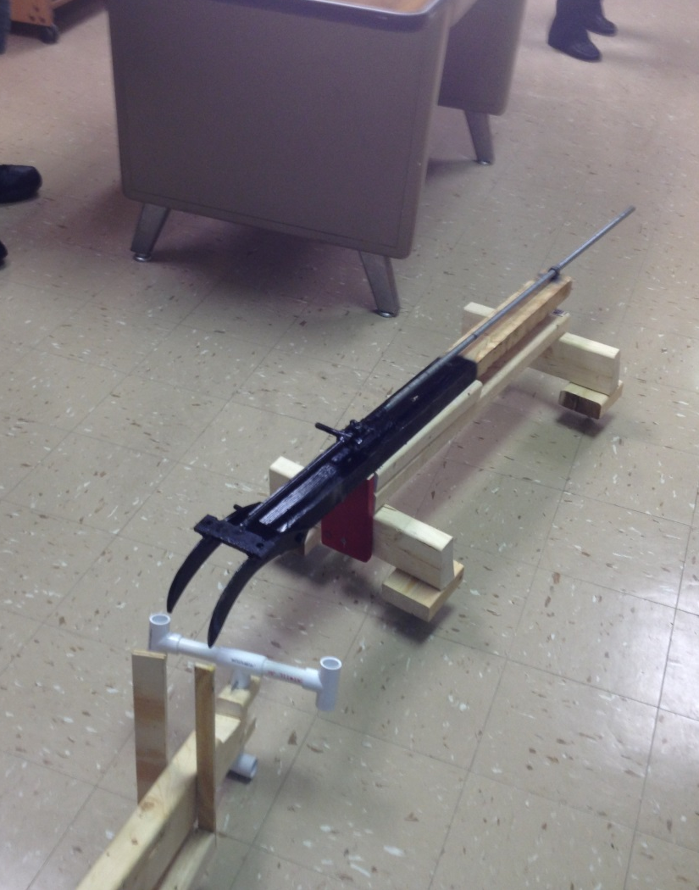
Spring 2013- Featured Design Solutions
T-pin Hitch
Notes:
22

Slide 23
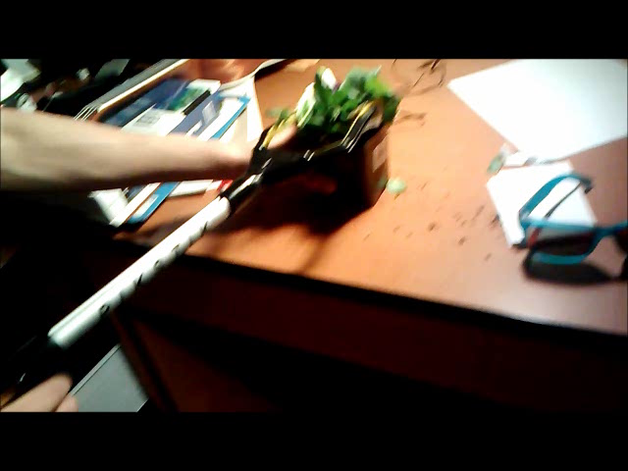
Spring 2013- Featured Design Solutions
Greenhouse Grabber Tool
Notes:
23

Slide 24
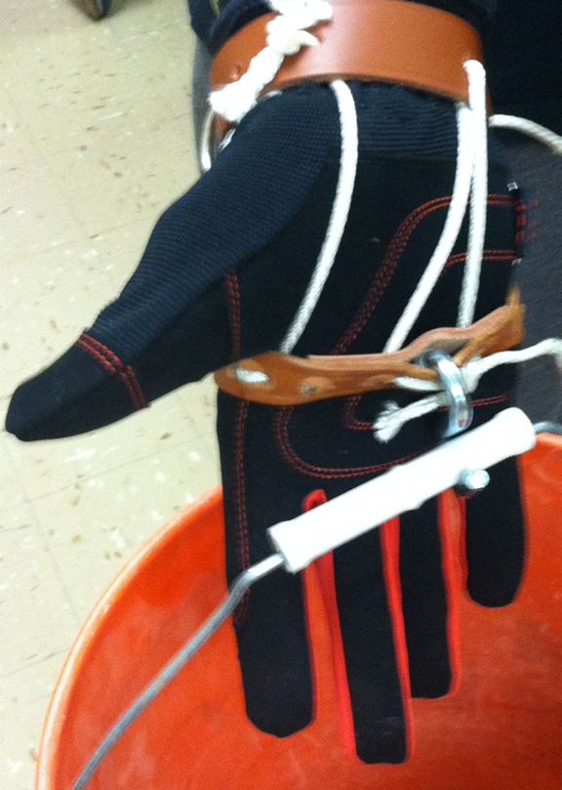
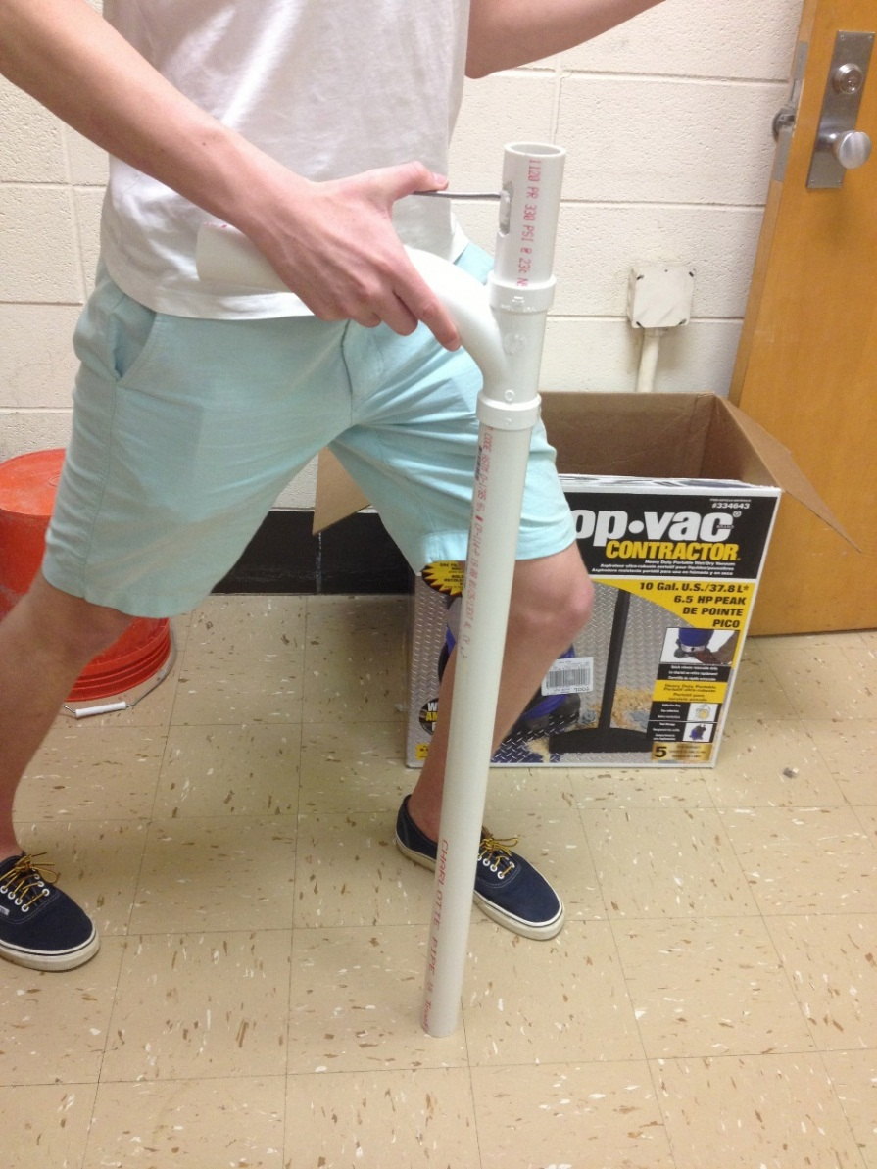
Spring 2013- Featured Design Solutions
Hook Glove
Retractable Utility Cane
Notes:
24

Slide 25
Fall 2013- Featured Design Solutions
Key difference: Most agriculture experience of any prior semester of students; farm-dairy site visit
6 total design solutions
Other designs:
  Modified wrist brace-arthritis
  Universal handle controls for
  Tractors
  Water runoff filtration system
  Riding mower harness system
Notes:
25

Slide 26
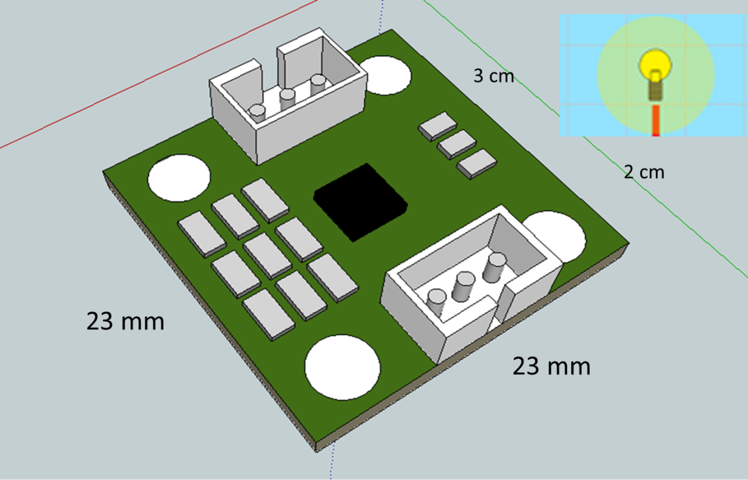
Fall 2013- Featured Design Solutions
Sensor to Alert/Prevent Tractor Overturns
Notes:
26

Slide 27
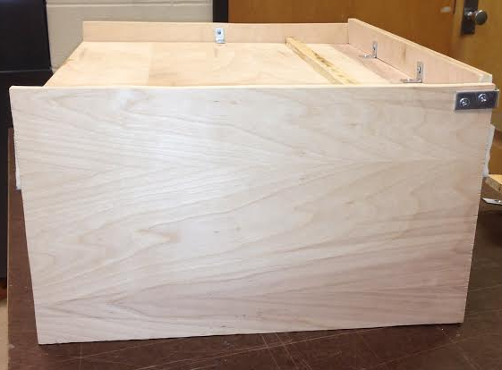
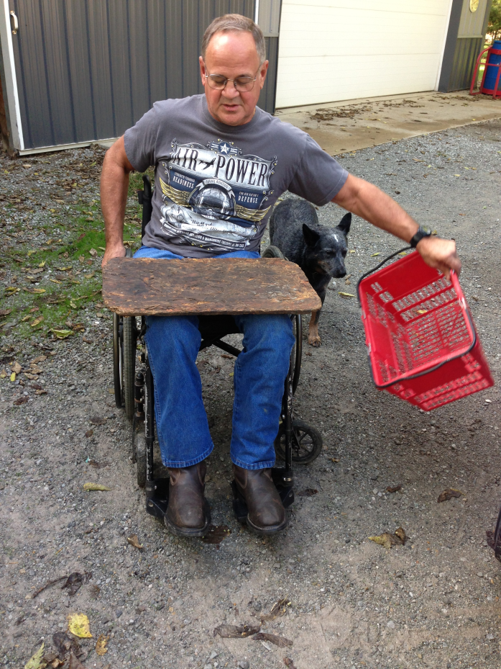
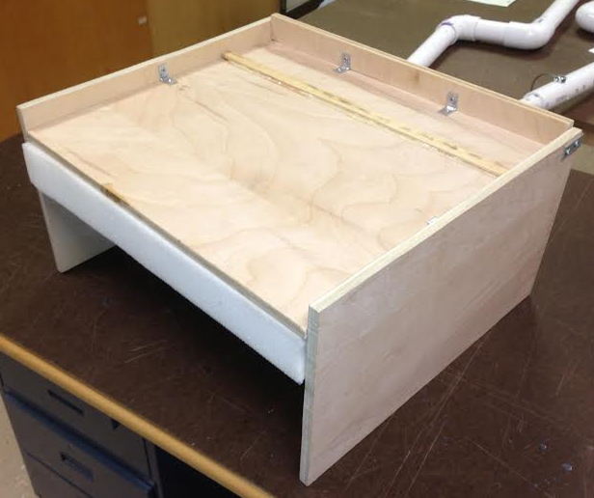
Fall 2013- Featured Design Solutions
Universal Lap Holder/Garden Seat/Garden Kneeler
Notes:
27

Slide 28
Spring 2014- Potential Design Solutions
Key difference: most students with no agriculture experience
7 total proposed design solutions
Potential designs:
  Mobility cart
  Support belt for posture and back support
  Rain collection system
  Greenhouse mobility harness lift system
  Versatile utility glove
Notes:
28

Slide 29
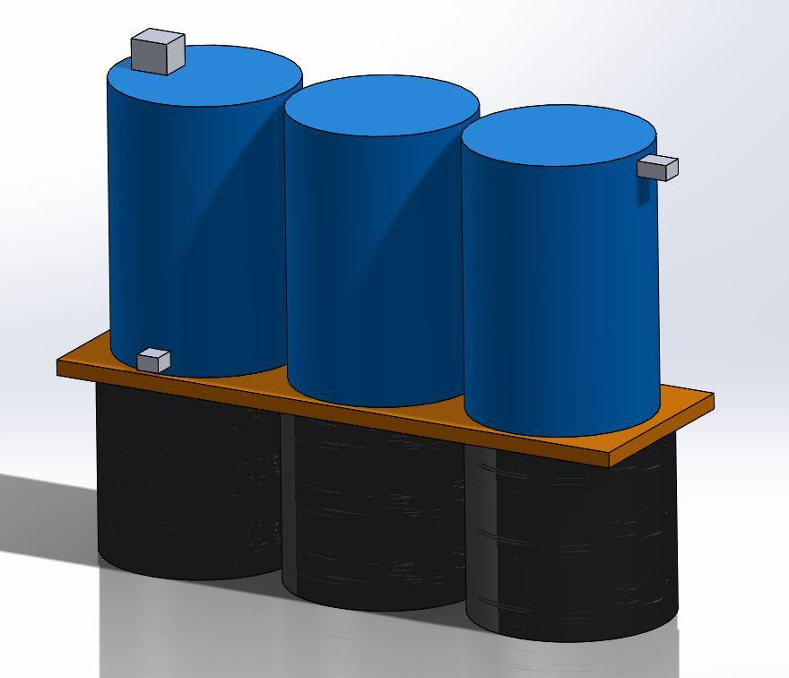
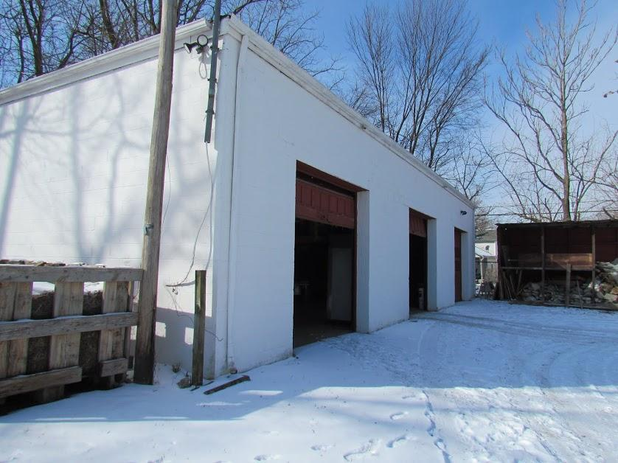
Spring 2014- Potential Design Solutions
Rain Barrel- Water Collection System for Mission of Mary
Cooperative (urban farm)
Notes:
29

Slide 30
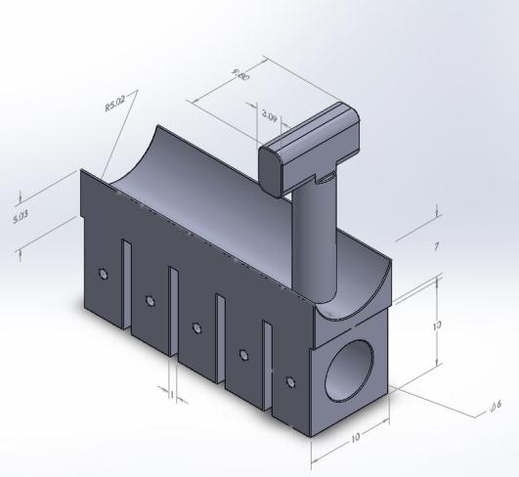
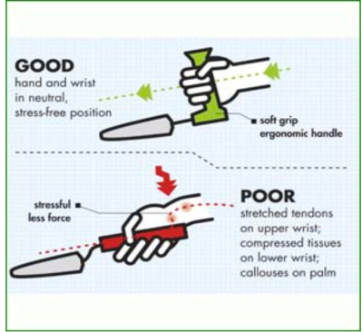
Spring 2014- Potential Design Solutions
"Toolbox Menu." The Toolbox: Assistive Technology Database. Purdue University, 2013. Web. 27 Feb. 2014.
Field, William E. "Breaking New Ground: Assisting Farmers with Disabilities Through the Application of Assistive Technology." Journal of Mine Action 6.3 Victim Assistance. Purdue University, n.d. Web. 27 Feb. 2014.
Arm Band Utility Cuff/Band for
Handling Tools (interchangeable)
Notes:
30

Slide 31
Student Comments- Fall 2012
What did you like about this course?
  “experience working with team members” (3 responses)
  “AgrAbility was awesome, fun project” (2 responses)
  “designs helped real people”
  “getting to see project through from beginning to end”
Notes:
31

Slide 32
Student Comments- Spring 2013
What did you like about this course?
  “we were able to design solutions for actual clients”
  “it was neat to be doing actual engineering projects as a freshman”
  “being able to have experience with engineering projects, having a client”
  “the broadness of the project”
  “feedback from the client”
  “team aspect and hands-on project”
  “projects . . . were very fun and engaging”
  “building the design”
  “it was comprehensive and useful”
  “interesting topic” and “real world application”
  “I liked . . . the whole new experience that this course had, it was closer to the professional career”
Notes:
32

Slide 33
Student Comments-Fall 2013
What did you like about this course?
  “design projects were fun/interesting” (7 responses)
  “interactive projects”
  “teamwork” (4 responses)
  “everything; real world projects/clients” (3 responses)
  “open-ended problem statement” (2 responses)
  “our own designs to work on” (2 responses)
  “portfolio for future employment; seeing what engineers actually do”
  “hands-on activities” (2 responses)
  “creativity” (2 responses)
  “Ohio AgrAbility design; relaxed environment; open-ended with different paths of success”
Notes:
33

Slide 34
Student Reflections
“I gained a lot more respect for the everyday farmer because of the risks that they take”
“some of the injuries that can happen on a farm really surprised me”
“I learned just how common it is for farmers to be injured but still keep working on a farm in conditions which don’t properly suit their new, injured lifestyle”
“I had no idea that there were so many health issues associated with farming, and when I learned about these I was excited to try and come up with a design that could potentially help a disabled farmer . . .”
“ . . . it was very exciting to have the opportunity to help others in need with engineering skills.”
“Even though I have had a lot of experience with farming I had never thought about some farmers struggling from disabilities”
Notes:
34

Slide 35
Student Reflections
“AgrAbility taught me a lot about farming and the dangers that come with farming”
“Through this project, I learned a lot more about farming than I ever had before”
“What shocked me . . . was the large population of disabled farmers that was creating for itself universal designs to make tasks easier and safer.”
Notes:
35

Slide 36
Student Reflections & Learning Outcomes
“I gained a lot more respect for the everyday farmer because of the risks that they take”
“some of the injuries that can happen on a farm really surprised me”
“I learned just how common it is for farmers to be injured but still keep working on a farm in conditions which don’t properly suit their new, injured lifestyle”
“I had no idea that there were so many health issues associated with farming, and when I learned about these I was excited to try and come up with a design that could potentially help a disabled farmer . . .”
Notes:
36

Slide 37
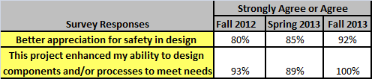
Learning Outcomes and Impact
Did you find the information provided by Ohio AgrAbility to be beneficial?
100% respondents answered YES
Did Ohio AgrAbility have a positive impact on your project?
  100% respondents answered YES
Notes:
37

Slide 38
Learning Outcomes and Impact
How has the partnership increased your ability to design adaptations or new products to help farmers with disabilities?
  “Our clients/mentors were extremely helpful in their comments and critiques. They were attentive and actually paid attention to what we had to say. They definitely helped us be more open-minded when thinking about design selection and alternatives”
  “This problem with disabled farmers is something that I would work with in the future because it is so vital and it grew my ability to think constructively and creatively”
  “Looking at how a handicapped individual lives their life really gave us the inspiration to design a product that would help”
  “It has increased by ability to problem-solve. We were given a problem and the greatest challenge was narrowing down that problem to something specific, and this project helped with those skills”
  “I am very happy that we got to have Ohio AgrAbility as our client!”
  “ . . . going to the actual farm and seeing the things that were used helped to see what products or designs we would be able to make to help injured farmers.”
Notes:
38

Slide 39
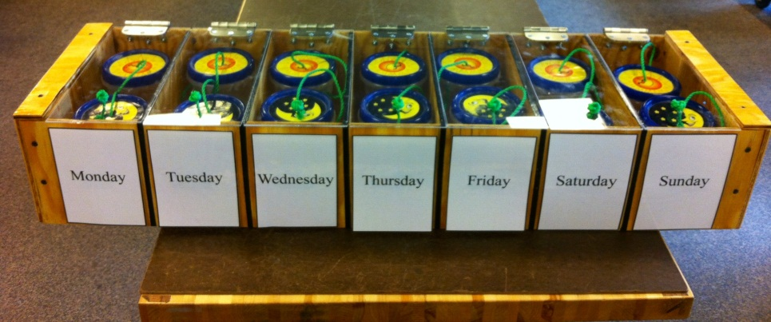
Knowledge Transfer
University of Dayton Senior Design Project- Spring 2014
NSF Research Experiences for Teachers Project
  Safe Haven Farms Horse Feeder Device for Autistic Farmers
Some design solutions featured in ThinkTV® “Agricultural Engineering” video (sponsored by the Dayton Regional STEM Center)
Design prototypes shared at agriculture workshops and symposia in Ohio
Notes:
39

Slide 40
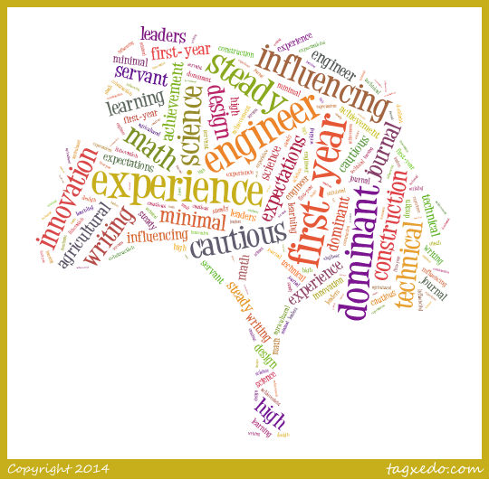
Innovation for Agriculture
Best Practices for project-based learning for introduction engineering design include. . .
  creating open-ended statements that require opportunity recognition
  stimulus and site visits
  a client or community partner
  regular interaction/feedback between students and clients
  faculty serving as key contacts and mentor
Service- learning and collaboration that . . .
  is ongoing and adaptive
  has clear outcomes for both partners
In the future, maybe we could. . .
  advance first-year projects to senior design
  create more verifiable, end-use designs

Slide 41
ACKNOWLEDGEMENTS
National AgrAbility Project
Ohio AgrAbility Project- leadership and staff
UD School of Engineering- funding and resources
Partners and supporters- Mission of Mary Cooperative (urban farm in Dayton, OH); Safe Haven Farms
Students and Teaching Assistants

